Slide 1
Made by:
Luka Kovjanić
Dominik Martić

Slide 2
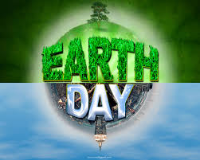
Earth Day is an yearly event, celebrated on April 22nd, on which events are held worldwide to demonstrate support for environmental protection. It was first celebrated in 1970 and celebrated in more than 192 countries each year.

Slide 3
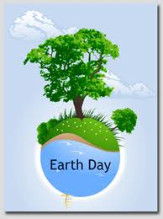
Growing eco-activism before Earth Day 1970
In 1968, Morton Hilbert and the U.S. Public Health Service organized the Human Ecology Symposium, an environmental meeting for students to hear from scientists about the environmental effects on human health. This was the beginning of Earth Day. For the next two years, Hilbert and students worked to plan the first Earth Day. In April 1970 first Earth Day was held.

Slide 4
Earth Day anthem
There are many songs that are performed on Earth Day, that generally fall into two categories. Popular songs not specific to Earth Day that are under copyright or new lyrics adapted to children's songs. UNESCO has called Indian poet-diplomat Abhay K's idea of an official Earth Anthem as a creative and inspiring thought that would contribute to bringing the world together. Earth Anthem by Abhay K is in eight languages including all official languages of the United Nations. It was launched in June 2013 on the occasion of the World Environment Day. India's Central Board of Secondary Education has started using it for educational purposes.

Slide 5
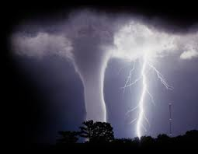
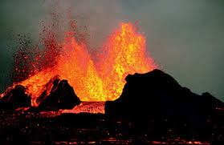
Natural disasters
Volcanic eruptions, fires, droughts, floods, earthquakes, hurricanes and tornadoes are happening every year. But, because of climate changes, they will be more dangerous in the future. In American history hurricane Katrina was the deadliest disaster of all times know to man.

Slide 6
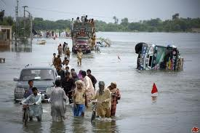
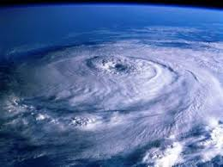
Tsunami
Flood
Hurricane

Slide 7
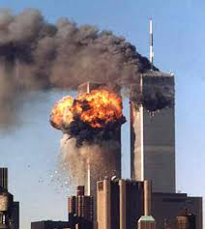
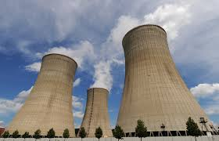
Terrorism, AIDS, nuclear power...
With help of new technology, terrorist organization are becaming more powerfull and dangerous threat to all people. So if in USA it’s not safe how can it be here if they attack?
Nuclear power is one of the cheapest sources of energy, but its disposal of radioactive waste has very harming effects on people.
AIDS is a worldwide disease caused by virus HIV. It’s mostly spread in Africa. It can’t be cured but you can get drugs to expand your life.

Slide 8
Recycling
Recycling is a process to change materials into new products to prevent waste of potentially useful materials. We need to reduce the consumption of fresh raw materials, reduce energy usage, reduce air and water pollution by reducing the need for "conventional" waste disposal.

Slide 9
Earth Day quiz
On which date is Earth Day celebrated?
Can you help the evironment to stay healty, how?
Should you and your parents recycle and why?
Name all natural disasters that you know or remember from presentation.
Explain effects of new technology on terrorist.
Do you know how could we safetly dispose nuclear waste?

Slide 10
QUIZ
1) Don't leave the ___________running when you are brushing your teeth.
2) Take a ______________ instead of a bath.
3) If you litter ___________will eat the garbage and get sick.
4) We can ____________by using both sides of the paper.
5) Use a reusable juice container instead of a _______________.
6) Planting just one ____________ can save the sky from smoke from factories.
7) Turn off the __________ and ______ when you are not in the room.
8) Keep the oceans clean so the fish will stay ___________ and safe.
9) Make a _____________________. The birds in the city have a hard time finding enough food to eat.
10) Recycle your plastic and __________ .
11) Use a ______________ instead of a paper bag.
animals, healthy, bird feeder, tree, juice box, lights,
shower, cans, recycle, TV, water, lunch box

